Slide 1

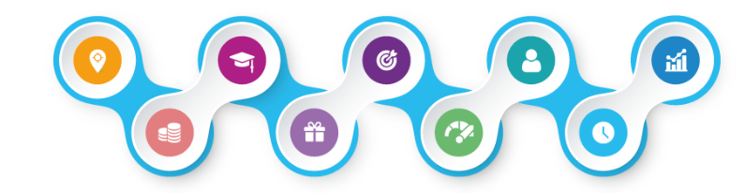
Mobile App

Slide 2
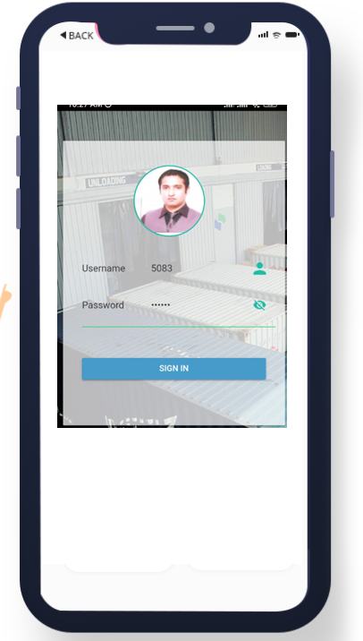
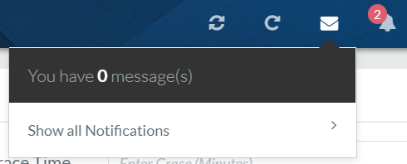
-Self Service Portal
-Integrated Push Notifications
-High Quality Image Resolution
-Responsive App Design
-Robust Security
-Live Updates

Slide 3
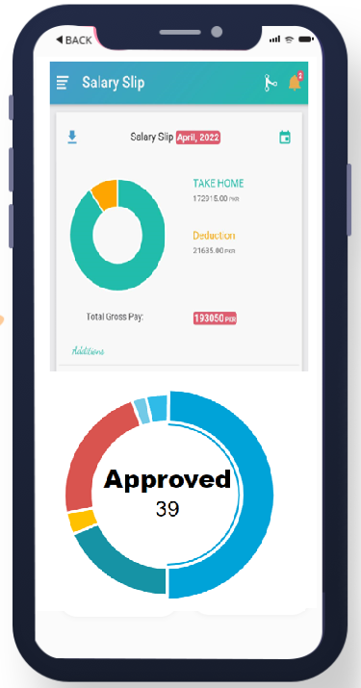
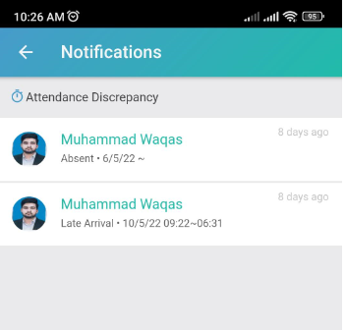
-Dashboard Components including Salary Slip
-Download supported
-Notifications / Approval Workflow

Slide 4
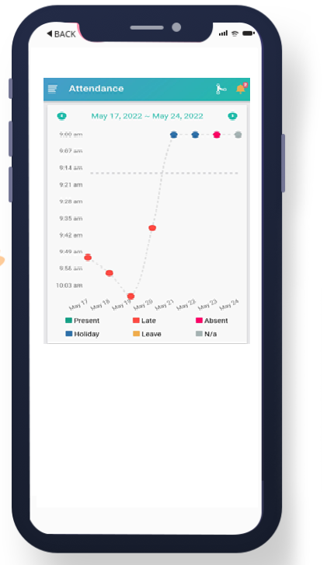
-View Current Month’s Attendance Status
-Apply Attendance

Slide 5
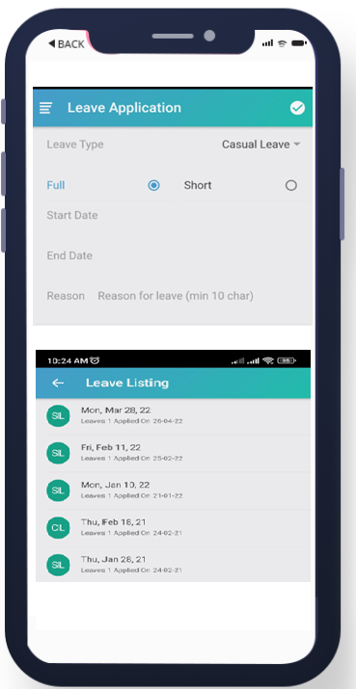
-View Leave Balance
-Apply for Leaves
-Leave Listings

